Slide 1
BRIGHT COFFEE SHOP
2023 Sales Performance & Growth Roadmap
Prepared for the CEO • Junior Data Analyst • Jan – Jun 2023

Slide 2
Agenda
1
Executive Summary & Key KPIs
2
Revenue Performance — Categories, Stores, Trend
3
Customer Behavior — 30-Min Time-Slot Analysis
4
Product Performance — Top & Bottom Sellers
5
Strategic Recommendations
6
Next Steps & Roadmap

Slide 3
Executive Summary — Headline KPIs
$698,812
214,470
149,116
Total Revenue
Units Sold
Transactions
Jan – Jun 2023
across 80 SKUs
avg ticket $4.69
3
+104%
08:00–11:00
Store Locations
Revenue Growth
Peak Window
NYC: Hell's Kitchen, Astoria, L. Manhattan
Jan → Jun
36% of daily revenue

Slide 4
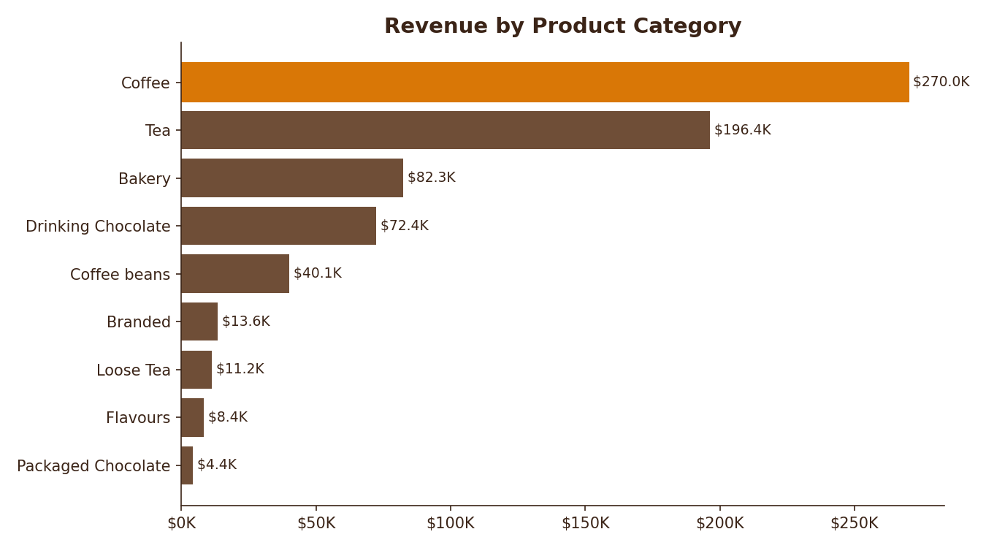
Revenue by Product Category
INSIGHTS
• Coffee dominates — $270K (39%)
• Tea is #2 — $196K (28%)
• Coffee + Tea + Bakery = 78% of sales
• Packaged Chocolate is the smallest category at <1%
• Beverage-led mix; food attach is an upside

Slide 5
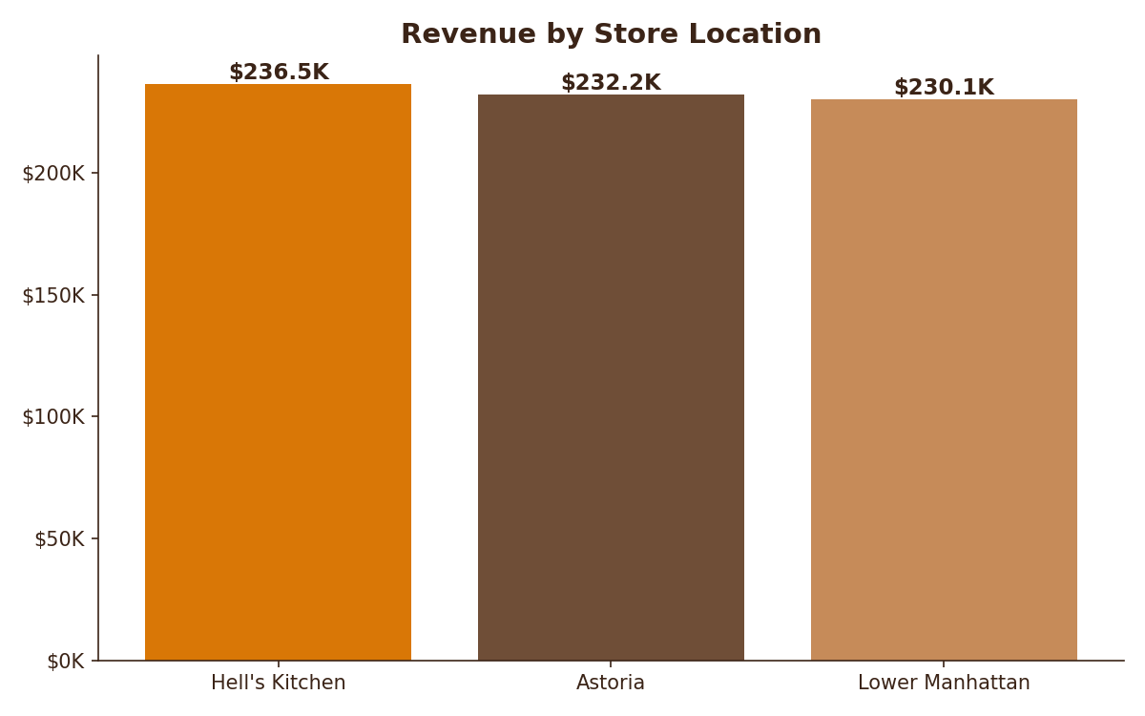
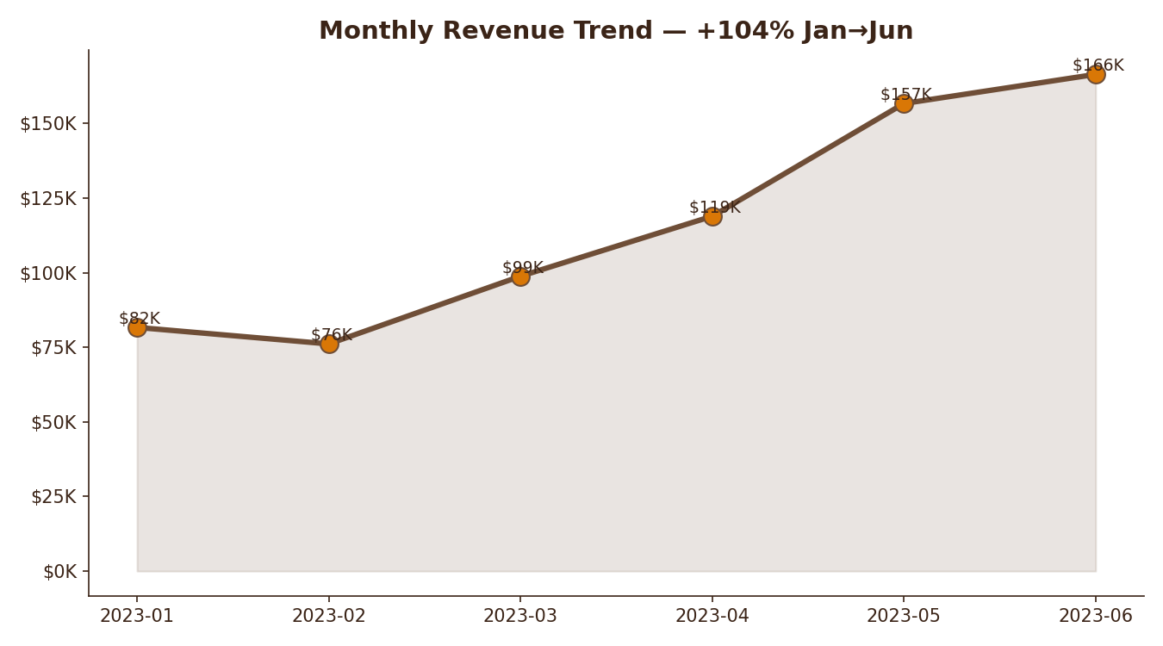
Store Performance & Monthly Trend
Stores are remarkably balanced (~$232K each). Revenue more than doubled from Jan ($82K) to Jun ($166K) — strong momentum.

Slide 6
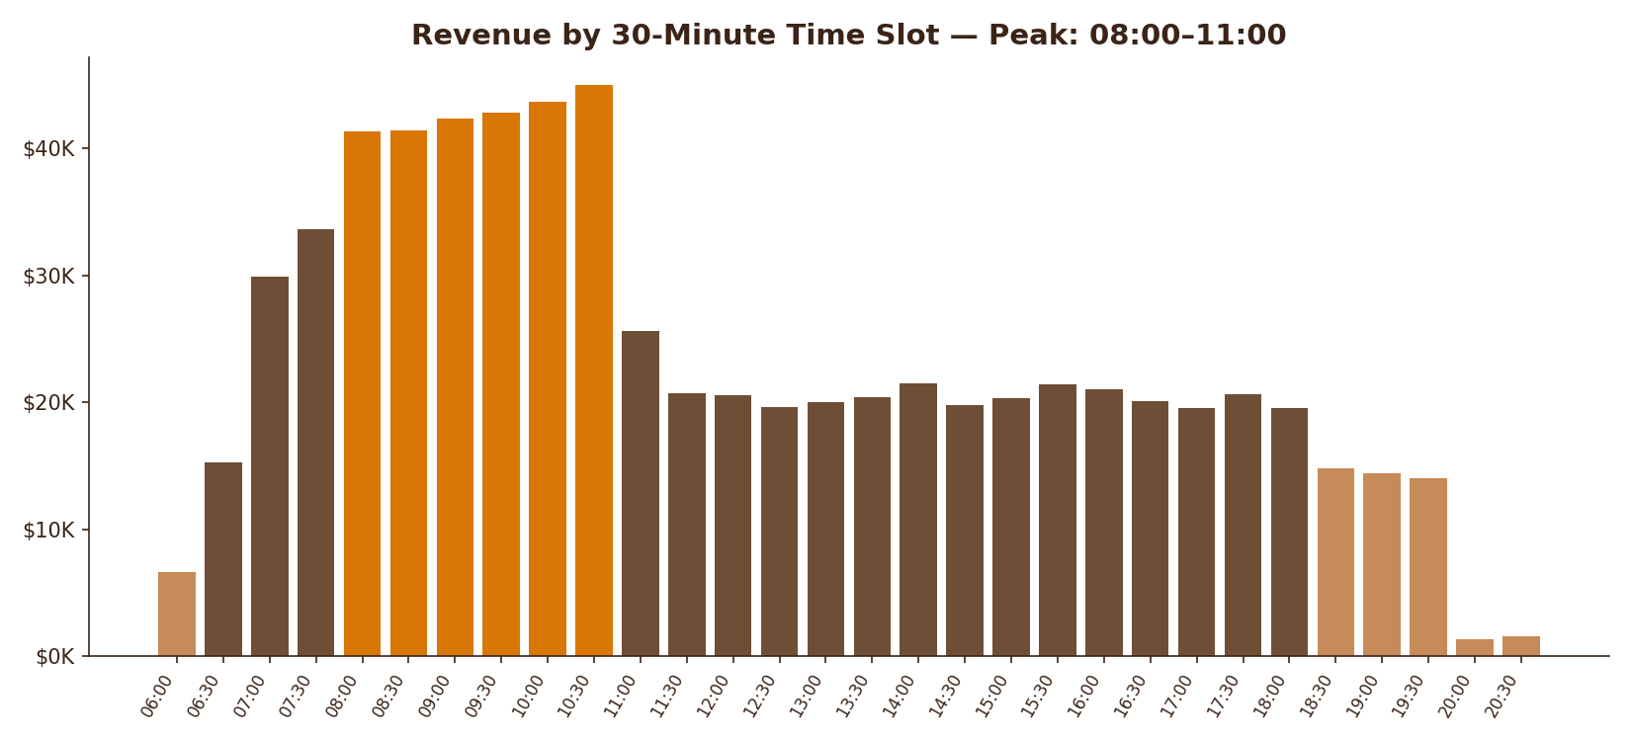
Sales by 30-Minute Time Slot
PEAK / OFF-PEAK
PEAK
08:00 – 11:00
$257K (36%)
STEADY
11:00 – 18:00
Flat ~$20K each slot
OFF-PEAK
06:00, 18:30 – close
< $15K per slot
DEAD
After 20:00
< $3K — review hours

Slide 7
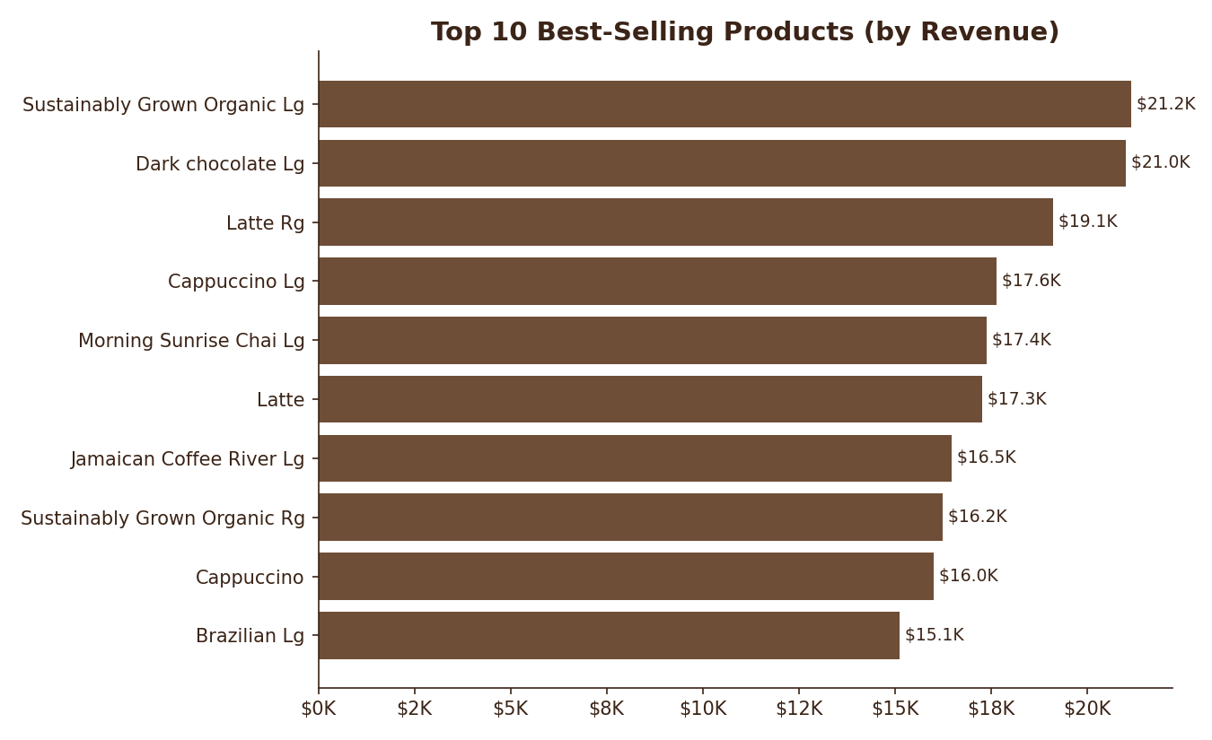
Top 10 Best-Selling Products
ACTION
• Top 10 SKUs = $177K (25% of total)
• Sustainably Grown Organic Lg leads at $21.2K
• 'Lg' (Large) sizes dominate — upsell works
• Stock these to never go out-of-stock
• Feature in combo deals & loyalty rewards

Slide 8
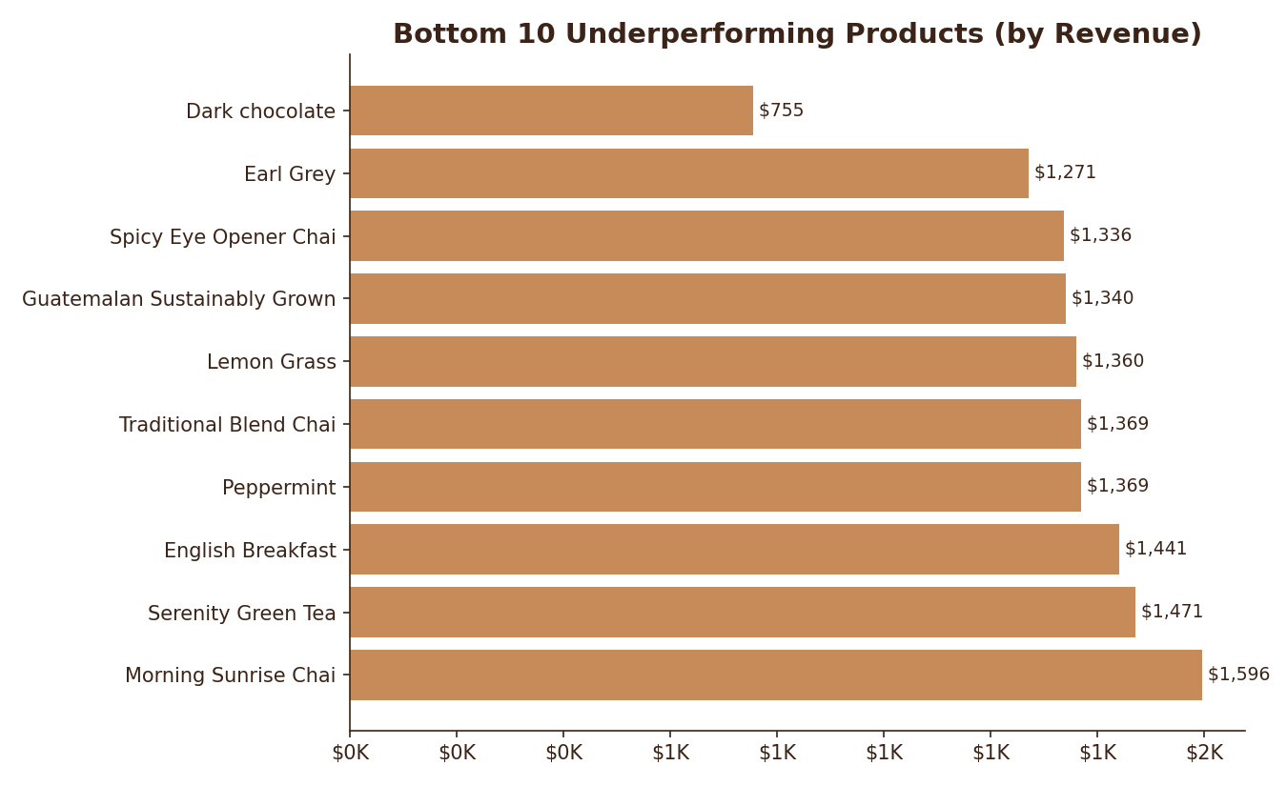
Bottom 10 Underperforming Products
DIAGNOSIS
• All bottom SKUs are 'Regular' size variants
• Lg counterparts often top sellers
• Size/price gap drives upsell — keep small for entry
• Promote via 'try-it' samples, bundles
• Discontinue only if margin < threshold

Slide 9
Strategic Recommendations
Happy Hour 14:00 – 17:00
01
20% off pastries + drink combo to lift the mid-day plateau (~$20K/slot). Target +15% revenue in window.
Stock-Up Bestsellers
02
Guarantee 100% in-stock for top 10 SKUs (Sustainably Grown Lg, Dark Chocolate Lg, Latte Rg). Set auto-reorder thresholds.
Promote Underperformers
03
Pair bottom-10 'Rg' items as free upgrades or in 'Try Something New' loyalty rewards.
Morning Combo Push
04
08:00–11:00 already drives 36% — add 'Coffee + Pastry' bundle to lift avg ticket from $4.69 → $5.50.
Close Late Hours
05
After 20:00 generates < $3K total — evaluate closing 1h earlier to cut labor.

Slide 10
Next Steps & Roadmap
AUTOMATE
EXPAND
Daily sales dashboard
Multi-store tracking
Databricks job → Snowflake → Power BI auto-refresh each morning at 06:00
Standardize KPIs across 3 stores; ready to onboard new locations
ENGAGE
MEASURE
Loyalty program
A/B test campaigns
Reward repeat customers in 08:00–11:00 peak; push notifications for off-peak visits
Instrument promotions; track lift on 30-min slot revenue weekly

Slide 11
Thank You
Questions & Discussion
Bright Coffee Shop • Sales Insights 2023

